Slide 1
The Battle of the Neighbourhoods

Slide 2
Introduction
Using the Toronto API Data from Foursquare Inc, we will be looking at the borough of Downtown Toronto (or any other desired borough)
The problem: As a bustling city, Downtown Toronto is full of places and things to see. As a tourist or a new resident, it can be overwhelming very quickly. Using this foursquare API data along with borough and the neighbourhood we are in, we can determine the most common types of venues and their exact location on a map
Trying to determine:
1. Determine the most common type of venue in downtown Toronto
2. Determine what is the most common type of cuisine in Downtown Toronto

Slide 3
Target Population
New residents and tourists of Toronto, Canada
Traveling business people looking to find the types of food and venues near them

Slide 4
Data Section
Data: https://en.wikipedia.org/wiki/List_of_postal_codes_of_Canada:_M
Foursquare API Developer Data
Focus on Downtown Toronto

Slide 5
FOURSQUARE API
Foursquare is a location data provider with information about all manner of venues and events within an area of interest.
Such information includes venue names, locations, menus and photos depending on the type of API call you make
The Foursquare location platform will be used as the main data source since all the required information for Toronto can be obtained through them

Slide 6
FOURSQUARE API DATA
The data retrieved from Foursquare contained information of venues within a specified distance of the longitude and latitude of the postcodes. The information obtained per venue as follows:
Neighbourhood
Latitude
Longitude
Venue
Name
Latitude
Longitude
Category

Slide 7
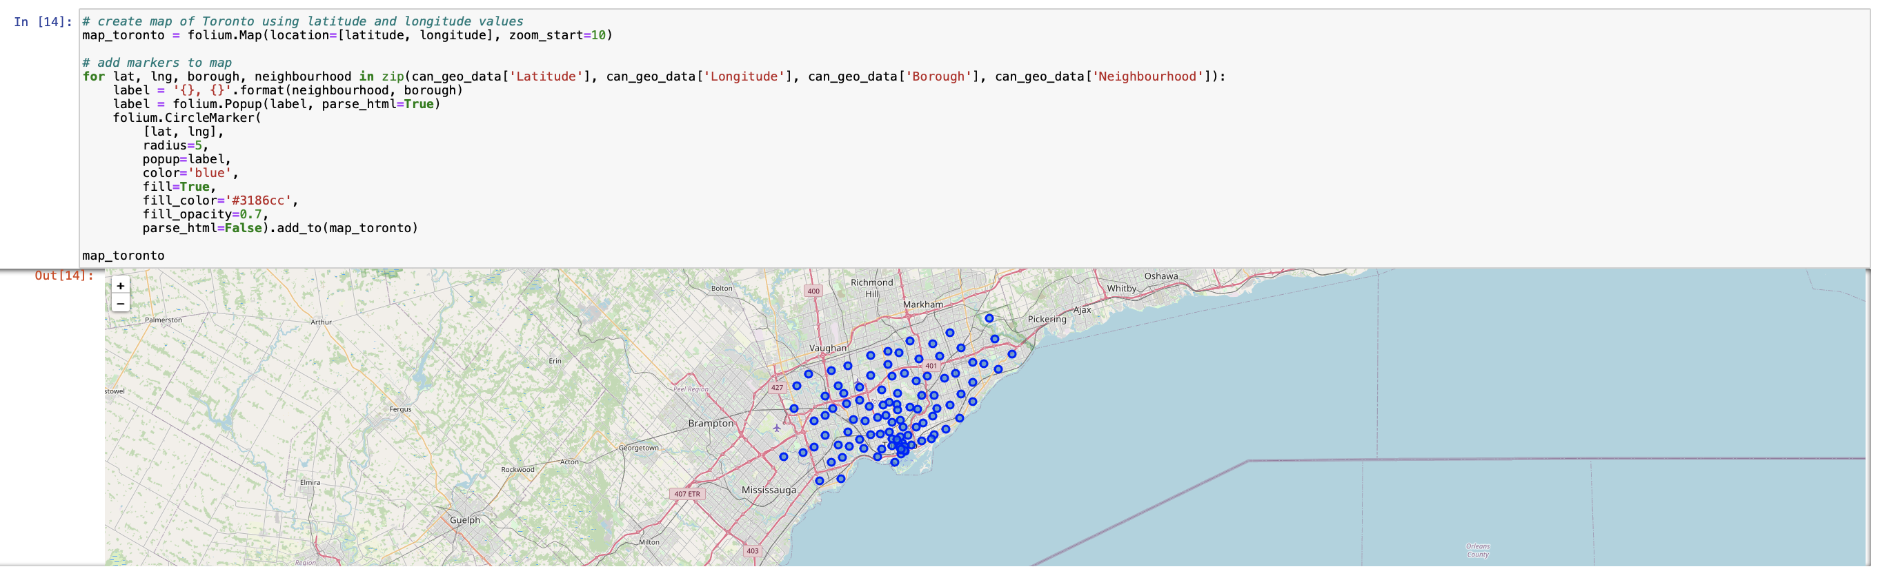
Map of Toronto neighbourhoods

Slide 8
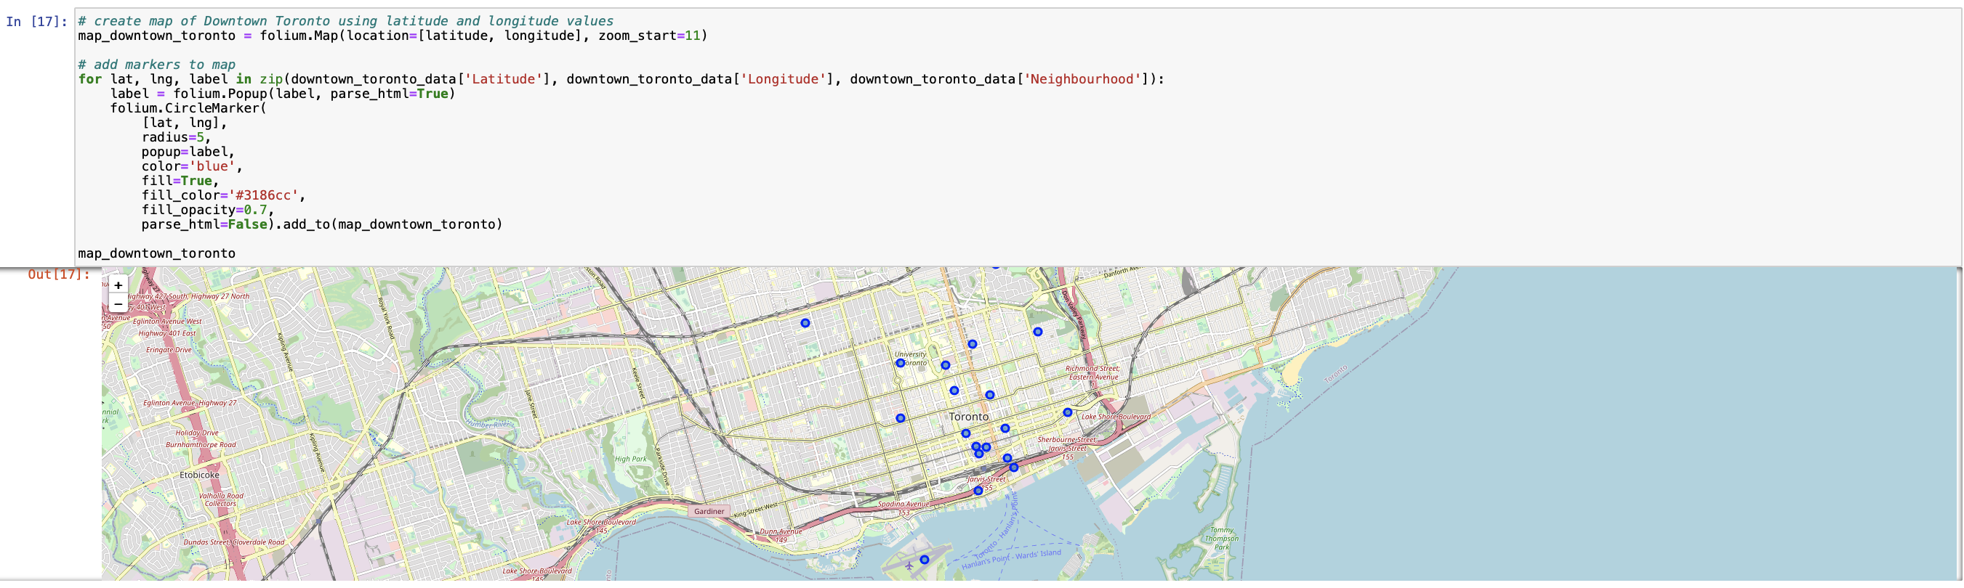
Map of Downtown Toronto neighbourhoods

Slide 9
Methodology
K-Means Clustering :
To compare the neighbourhoods within Toronto, and specifically Downtown Toronto for newcomers and visitors
In order to do that, we need to cluster the data. This can be done using an unsupervised machine learning approach known as the K-means clustering algorithm

Slide 10
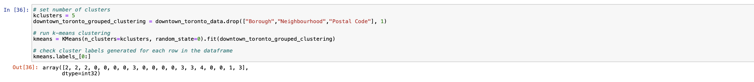
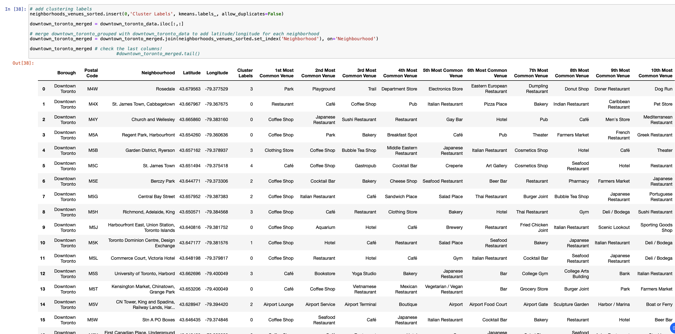
K-MEANS CLUSTERING

Slide 11
WORKFLOW
Using Foursquare API Location data from Developer website to obtain all necessary information for Toronto and its neighbourhoods
Due to API request limits, the radius was set to 100 and the calls to 500

Slide 12
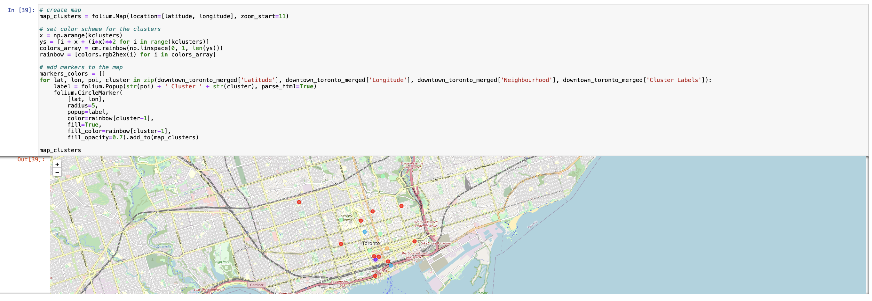
Results: Map of Downtown Toronto using k-means clustering

Slide 13
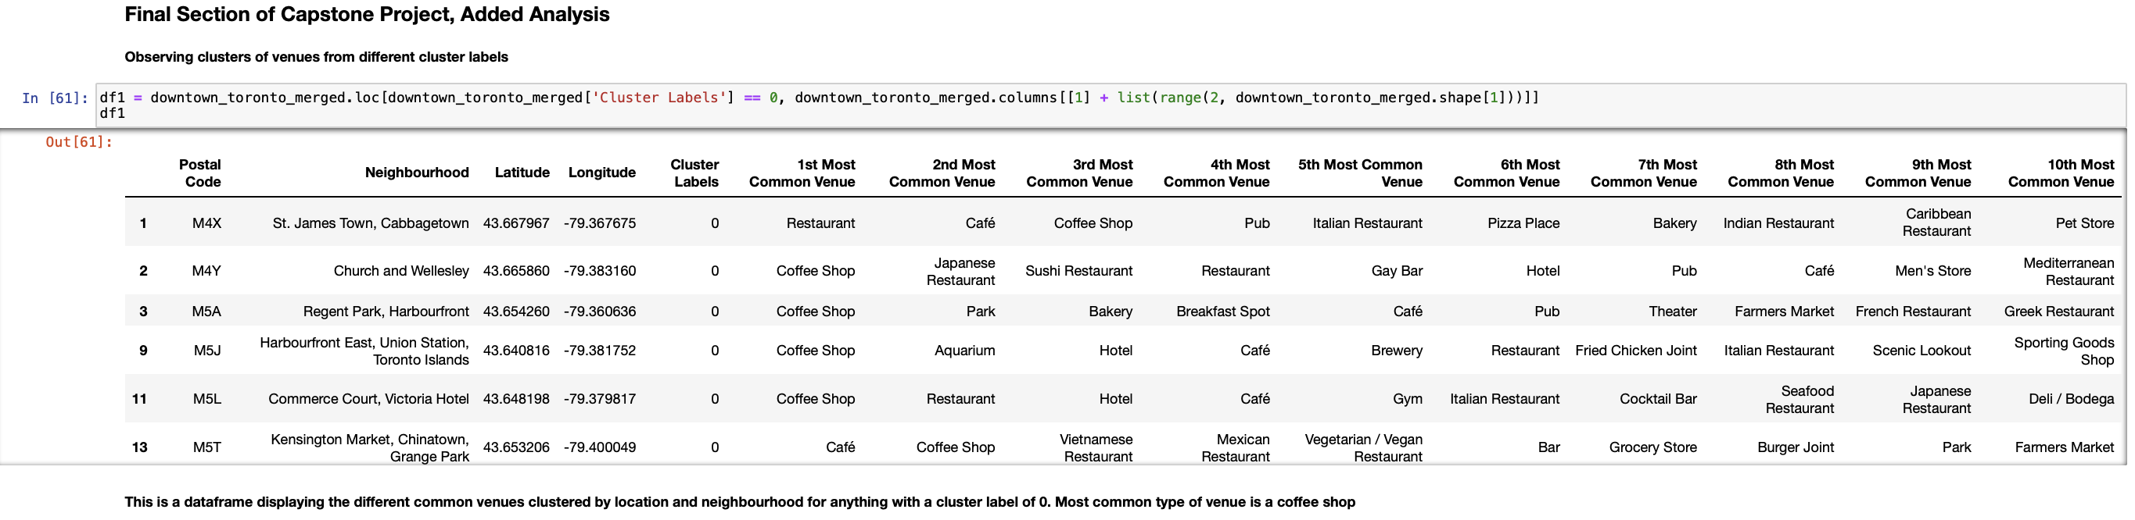
Results: Downtown Toronto dataframes from k-means clustering

Slide 14
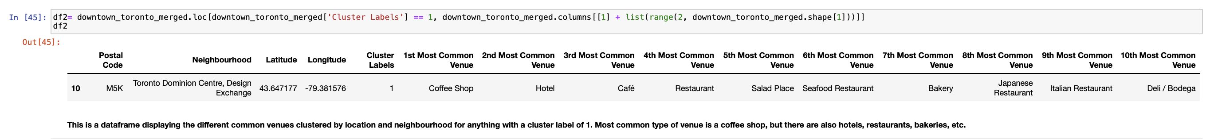
Results: Downtown Toronto dataframes from k-means clustering

Slide 15
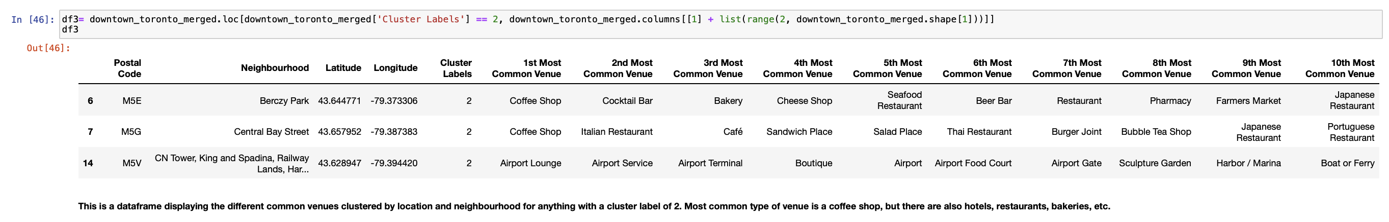
Results: Downtown Toronto dataframes from k-means clustering

Slide 16
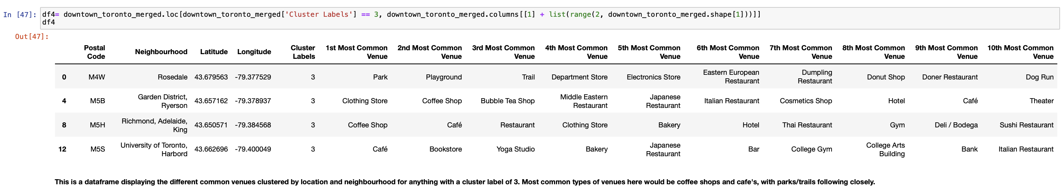
Results: Downtown Toronto dataframes from k-means clustering

Slide 17
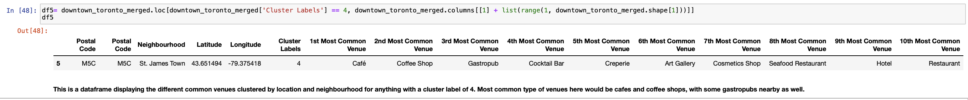
Results: Downtown Toronto dataframes from k-means clustering

Slide 18
Discussion
The purpose of this project was to find the most common venues in downtown Toronto based on postal code and k-means clustering to obtain information for newcomers and visitors alike.
Mapped the different suburbs based on clusters and inspected the data frames based on the clusters to determine the most common type of venue(s) present in each area.
This helps people decide where to go for the type of venue(s) they are looking for at that time or a particular situation

Slide 19
Conclusion
During this project, the k-means algorithm was employed in order to cluster types of venues near certain postal codes within the downtown Toronto area. This helped us discover which types of venues are most common in the downtown Toronto neighbourhood and therefore can decide which part of downtown Toronto to visit for whatever it is the person is looking for
Using the dataframes above, one can see the most common venues for each neighbourhood and their respective locations, so it makes it easy to find the type of place you are looking for.

Slide 20
Python Libraries and Packages Used
Pandas: For creating and manipulating dataframes.
Folium: Python visualization library would be used to visualize the neighbourhoods cluster distribution of using interactive leaflet map.
Scikit Learn: For importing k-means clustering.
JSON: Library to handle JSON files.
XML: To separate data from presentation and XML stores data in plain text format.
Geocoder: To retrieve Location Data.
Beautiful Soup and Requests: To scrap and library to handle http requests.
Matplotlib: Python Plotting Module

